Slide 1

BIG DATA TOOLS FOR MANAGERS
Unit-2 : Data Retrieval using MySQL
by
Ankit Velani
Adjunct Faculty, Dept. of MBA,
Siddaganga Institute of Technology,Tumkur

Slide 2
Data
Data is a collection of a small piece of information. It can be used in a variety of forms like text, numbers, media, bytes…etc
i.e. Student data, Employee data, Events data, Travelling data

Slide 3
Database
A database is an organized collection of data so that it can be easily managed and accessible.
Student data
Employee data
Event data
Database
Movies data
Exam data
Sports data

Slide 4

DBMS
Data Base Management System is software used to store and retrieve the database.

Slide 5
RDBMS
Relational Data Base Management System
All the modern database systems like MySQL, ORACLE…etc are based on RDBMS.
In RDBMS, data are stored in form of Tables, and it allows to create relationships between tables.

Slide 6
RDBMS
Emp_ID | ENAME | POST | CITY
E1 | John | Manager | USA
E2 | Nick | Data Analyst | UK
E3 | Dom | Product Owner | UK
E4 | Paul | Project Owner | UK

Slide 7
RDBMS
Columns/ Attributes/ Fields
Emp_ID | ENAME | POST | CITY
E1 | John | Manager | USA
E2 | Nick | Data Analyst | UK
E3 | Dom | Product Owner | UK
E4 | Paul | Project Owner | UK
Records/
Tuples/
Rows

Slide 8
Table Creation
CREATE TABLE table_name (
col-name-1 data-type
col-name-2 data-type,
col-name-3 data-type,
col-name-4 data-type
);

Slide 9
Table Creation
CREATE TABLE table_name (
col-name-1 data-type
col-name-2 data-type,
col-name-3 data-type,
col-name-4 data-type
);
CREATE TABLE employee (
emp_id text,
ename text,
post text,
city text
);

Slide 10
Insert Records/Rows
INSERT INTO table_name VALUES (‘value-1’, ‘value-2’,……);
INSERT INTO employee VALUES ( ‘E1’,
‘John’,
‘Manager’,
‘USA’
);

Slide 11
Retrieve Data using SELECT
SELECT * FROM table_name;
(asterisk) represent all the columns
from table

Slide 12
Retrieve Data using SELECT
SELECT * FROM table_name;
SELECT * FROM employee;
SELECT ename FROM employee;
SELECT ename, city FROM employee;

Slide 13
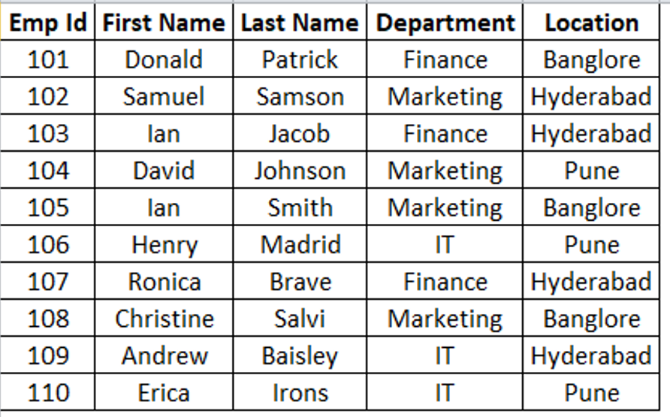
Create Employee_2 table in SQL

Slide 14
MySQL Data Types
The data type of a column defines what value the column can hold: integer, character, money, date and time, binary, and so on.
Each column in a database table is required to have a name and a data type.
In MySQL there are three main data types: string, numeric, and datetime.

Slide 15
String Types
CHAR(size)
A fixed-length string between 1 and 255 characters in length (for example CHAR(5)), right-padded with spaces to the specified length when stored
Example:
CREATE TABLE student(
usn CHAR(10)
);

Slide 16
String Types
VARCHAR(size)
A variable-length string between 1 and 255 characters in length.
Example:
CREATE TABLE student(
usn VARCHAR(10)
);

Slide 17
String Types
TINYTEXT
TEXT column with a maximum length of 255 characters
MEDIUMTEXT
TEXT column with a maximum length of 16777215 characters
LONGTEXT
TEXT column with a maximum length of 4294967295 or 4 GB of characters

Slide 18
String Types
Example:
CREATE TABLE student (
usn CHAR(10),
name VARCHAR(50),
address TINYTEXT,
city VARCHAR(20),
state VARCHAR(20),
pincode CHAR(5)
);

Slide 19
Numeric Types
Data Type | Signed range(Number with Sign) | Unsigned range
TINYINT | -128 to 127 | 0 to 255
SMALLINT | -32768 to 32767 | 0 to 65535
MEDIUMINT | -8388608 to 8388607 | 0 to 16777215
INT | -2147483648 to 2147483647 | 0 to 4294967295
BIGINT | -9223372036854775808 to 9223372036854775807 | 0 to 18446744073709551615
FLOAT | Decimal precision can go to 24 places for a float type
DOUBLE | Decimal precision can go to 53 places for a double

Slide 20
DateTime Types
Data Type Syntax | Maximum Size
DATE | Values range from '1000-01-01' to '9999-12-31'.
TIME | Values range from '-838:59:59' to '838:59:59'.
DATETIME | Values range from '1000-01-01 00:00:00' to '9999-12-31 23:59:59'.
TIMESTAMP | Values range from '1970-01-01 00:00:01' UTC to '2038-01-19 03:14:07’ UTC.

Slide 21
Recap…
String Data Type:
CHAR
VARCHAR
TINYTEXT
MEDIUMTEXT
LONGTEXT
Numeric Data Type:
TINYINT
SMALLINT
MEDIUMINT
INT
BIGINT
FLOAT
DOUBLE
Date Data Type:
DATE
TIME
DATETIME
TIMESTAMP

Slide 22
Example : String, Int, and DateTime
Example:
CREATE TABLE students (
usn CHAR(10),
name VARCHAR(50),
dob DATE,
age TINYINT,
degree_per FLOAT,
address MEDIUMTEXT
);

Slide 23
String, Int, and DateTime
** Numeric data should be without single or double quotes.
Example:
INSERT INTO students
VALUES (
'MBA01',
'Paul S',
'1991-09-08',
30,
70.80,
'B.H. Road, Tumkur 572103, Karnataka’
);

Slide 24
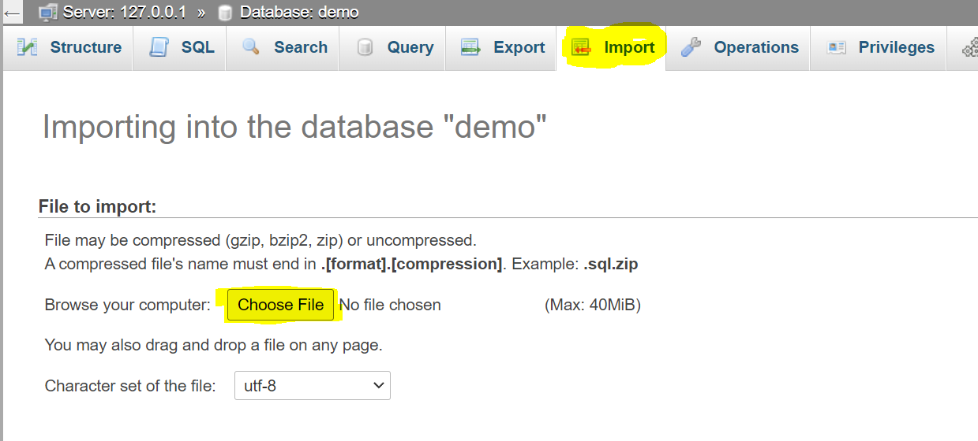
Import data in MySQL
Download customer.sql file :
https://raw.githubusercontent.com/sitmbadept/sitmbadept.github.io/main/BDTM/SQL/customers.sql

Slide 25
Describe Table
DESCRIBE statement used to view the structure of a table in MySQL.
Syntax:
DESCRIBE table_name;
Example:
DESCRIBE customers;

Slide 26
SELECT Statement
The SELECT statement is used to select data from a database.
The data returned is stored in a result table, called the result-set.
Syntax
SELECT
column1, column2, column3,... FROM table_name;

Slide 27
SELECT Statement
Example
Display all the records & columns from Table:
SELECT * FROM customers;
Display all the records and selected column from Table:
SELECT
customerNumber,
customerName
FROM customers;

Slide 28
SELECT DISTINCT Statement
The SELECT DISTINCT statement is used to return only distinct (different) values.
Syntax
SELECT DISTINCT
column1, column2, column3,... FROM table_name;

Slide 29
SELECT DISTINCT Statement
Example:
Display all the countries from the country column in customers table.
SELECT country FROM customers;
Display unique/distinct countries from the country column in customers table
SELECT DISTINCT country FROM customers;

Slide 30
SELECT DISTINCT Statement
Example:
Display values for city and country columns from customers table.
SELECT city, country FROM customers;
Display unique/distinct values for city and country columns from customers table.
SELECT DISTINCT city, country FROM customers;

Slide 31
SELECT DISTINCT Statement
Example:
SELECT DISTINCT
city, state, postalCode, country
FROM customers;

Slide 32
Working with large text data
Download post.sql file from below link and import into phpMyAdmin
https://raw.githubusercontent.com/sitmbadept/sitmbadept.github.io/main/BDTM/SQL/post.sql
Execute SQL queries for following:
View Table Structure (DESCRIBE posts; )
View the table data

Slide 33
SQL WHERE Clause
The WHERE clause is used to filter records.
It is used to extract only those records that fulfill a specified condition.
WHERE Syntax:
SELECT
column1, column2, ... FROM table_name WHERE condition;

Slide 34
SQL WHERE Clause
The WHERE clause is used to filter records.
It is used to extract only those records that fulfill a specified condition.
WHERE Syntax:
SELECT
column1, column2, ... FROM table_name WHERE condition;

Slide 35
SQL WHERE Clause
The following operators can be used in the WHERE clause:
Operator | Description
= | Equal
> | Greater than
< | Less than
>= | Greater than or equal
<= | Less than or equal
<> | Not equal. Note: In some versions of SQL this operator may be written as !=
BETWEEN | Between a certain range
LIKE | Search for a pattern
IN | To specify multiple possible values for a column

Slide 36
SQL WHERE Clause
Condition can be apply in multiple columns using AND OR operators.
AND operator displays a record if all the conditions separated by AND are TRUE.
OR operator displays a record if any of the conditions separated by OR is TRUE.

Slide 37
SQL WHERE Clause
Example:
SELECT * FROM `customers` WHERE country = 'USA’;
SELECT * FROM customers
WHERE creditLimit BETWEEN 10000 AND 50000;

Slide 38
Recap…
String, Number and Date data types
Create Table
Insert data (String, Number, Date)
Import Data
Select DISTINCT
WHERE Clause

Slide 39
UPDATE statement
The UPDATE statement is used to modify the existing records in a table.
UPDATE Syntax: UPDATE table_name
SET column1 = value1, column2 = value2, ...
WHERE condition;
***without WHERE condition all the records gets updated in the table.
Column with new values

Slide 40
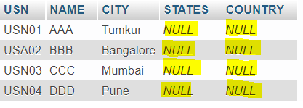
UPDATE statement
Download Data: https://bit.ly/3TERmqQ
SELECT * FROM students;

Slide 41
UPDATE statement
Update state name as per city
UPDATE students SET STATES='Maharashtra' WHERE CITY= 'Pune';
UPDATE students SET STATES='Maharashtra' WHERE CITY= 'Mumbai';
UPDATE students SET STATES='Karnataka'
WHERE CITY IN ('Tumkur','Bangalore');

Slide 42
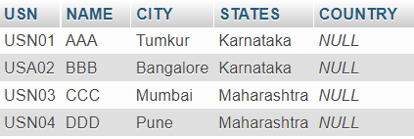
UPDATE statement
View Table Data:
SELECT * FROM students;

Slide 43
UPDATE statement
Update country as India for all the students
Example:
UPDATE students SET COUNTRY = 'India';
***without WHERE condition all the records gets updated in the table.

Slide 44
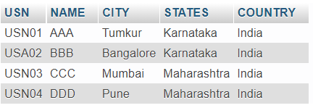
UPDATE statement
View Table Data:
SELECT * FROM students;

Slide 45
DELETE statement
The UPDATE statement is used to modify the existing records in a table.
Syntax:
DELETE FROM table_name
WHERE condition;
***without WHERE condition all the records gets deleted from the table.

Slide 46
DELETE statement
DELETE FROM students WHERE USN='USN01';
DELETE FROM students WHERE City='Pune';

Slide 47

DELETE statement
View Table data:
SELECT * FROM students;

Slide 48
TRUNCATE statement
The TRUNCATE TABLE statement is used to delete the data inside a table, but not the table itself.
Syntax:
TRUNCATE TABLE table_name;

Slide 49
TRUNCATE statement
The TRUNCATE TABLE statement is used to delete the data inside a table, but not the table itself.
Example:
TRUNCATE TABLE students;
View Table data:
SELECT * FROM students;

Slide 50
DROP TABLE Statement
The DROP TABLE statement is used to drop an existing table in a database.
Syntax:
DROP TABLE table_name;
Example:
DROP TABLE students;

Slide 51
MySQL Joins
A JOIN clause is used to combine rows from two or more tables, based on a related column between them.
Orders Table
Download Data : https://bit.ly/3TERmqQ
OrderID | CustomerID | OrderDate
10308 | 2 | 2022-08-15
10309 | 1 | 2022-08-26
10310 | 2 | 2022-09-01
Customers Table
CustomerID | CustomerName | Country
1 | John Todd | Germany
2 | Dominic Dom | Mexico
3 | Paul S | Mexico

Slide 52

INNER JOIN
The INNER JOIN keyword selects records that have matching values in both tables.
INNER JOIN Syntax
SELECT col-1, col-2….columns(s) FROM table1 INNER JOIN table2 ON table1.column_name = table2.column_name;

Slide 53
INNER JOIN
Example: Selecting all the columns from both the table
SELECT customers.* ,
orders.*
FROM customers
INNER JOIN orders
ON orders.CustomerID = customers.CustomerID;

Slide 54
INNER JOIN
Example: Selecting specified columns from tables.
SELECT orders.CustomerID,
orders.OrderID,
orders.OrderDate,
customers.CustomerName,
customers.Country
FROM customers
INNER JOIN orders
ON orders.CustomerID = customers.CustomerID;

Slide 55
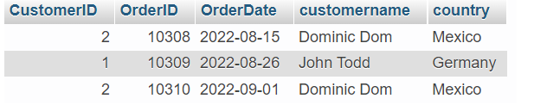
INNER
JOIN
Example: Selecting specified columns from tables
SELECT orders.CustomerID,
orders.OrderID,
orders.OrderDate,
customers.CustomerName,
customers.Country
FROM customers
INNER JOIN orders
ON orders.CustomerID = customers.CustomerID;
Output:

Slide 56
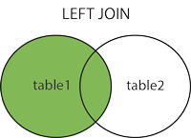
LEFT JOIN
The LEFT JOIN keyword returns all records from the left table (table1), and the matching records (if any) from the right table
LEFT JOIN Syntax
SELECT col-1, col-2….columns(s) FROM table1 LEFT JOIN table2 ON table1.column_name = table2.column_name;

Slide 57
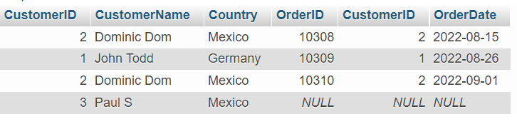
LEFT
JOIN
Example:
SELECT customers.* ,
orders.*
FROM customers
LEFT JOIN orders
ON orders.CustomerID = customers.CustomerID;
Output:

Slide 58
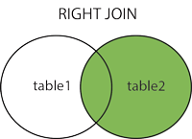
RIGHT JOIN
The RIGHT JOIN keyword returns all records from the right table (table2), and the matching records (if any) from the left table (table1)
RIGHT JOIN Syntax
SELECT col-1, col-2….columns(s) FROM table1 RIGHT JOIN table2 ON table1.column_name = table2.column_name;

Slide 59
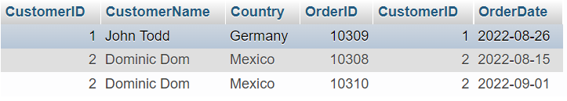
RIGHT
JOIN
Example:
SELECT customers.* ,
orders.*
FROM customers
RIGHT JOIN orders
ON orders.CustomerID = customers.CustomerID;
Output:

Slide 60
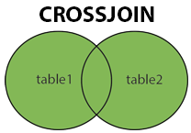
CROSS JOIN
The CROSS JOIN keyword returns all records from both tables (table1 and table2).
CROSS JOIN Syntax
SELECT col-1, col-2….columns(s) FROM table1 CROSS JOIN table2;

Slide 61
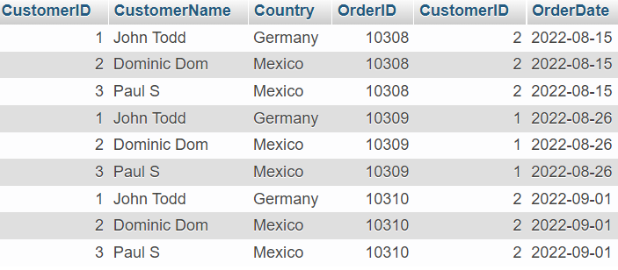
CROSS
JOIN
Example:
SELECT customers.* ,
orders.*
FROM customers
CROSS JOIN orders;
Output:

Slide 62
UNION Operator
The UNION operator is used to combine the result-set of two or more SELECT statements.
Important points for UNION operator.
Every SELECT statement within UNION must have the same number of columns.
The columns must also have similar data types
The columns in every SELECT statement must also be in the same order

Slide 63
UNION Operator
UNION Syntax
SELECT col1, col2,..etc FROM table1 UNION SELECT col1,col2,..etc FROM table2;
UNION ALL Syntax
SELECT col1, col2,..etc FROM table1 UNION ALL SELECT col1,col2,..etc FROM table2;
****The UNION operator selects only distinct values by default. To allow duplicate values, use UNION ALL

Slide 64
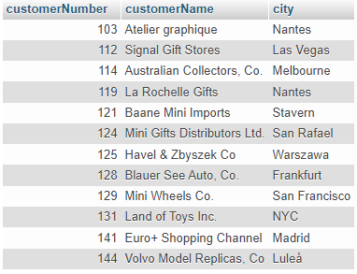
UNION
Example:
SELECT customerNumber, customerName, city FROM customers_1
UNION
SELECT customerNumber, customerName, city FROM customers_2;
Output:

Slide 65
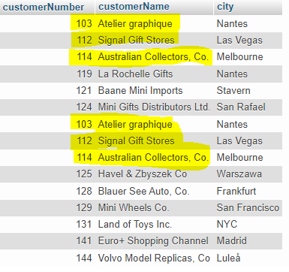
UNION
ALL
Example:
SELECT customerNumber, customerName, city FROM customers_1
UNION ALL
SELECT customerNumber, customerName, city FROM customers_2;
Output:

Slide 66
GROUP BY Statement
The GROUP BY statement groups rows that have the same values into summary rows, like "find the number of customers in each country.
The GROUP BY statement is often used with aggregate functions (COUNT(), MAX(), MIN(), SUM(), AVG()) to group the result-set by one or more columns.

Slide 67
MIN, MAX, COUNT, AVG, SUM Functions
MIN() function returns the smallest value of the selected column.
MAX() function returns the largest value of the selected column.
The COUNT() function returns the number of rows that matches a specified criterion.
The AVG() function returns the average value of a numeric column.
The SUM() function returns the total sum of a numeric column.

Slide 68
GROUP BY Statement
Syntax:
SELECT col-1, col-2, col-3 FROM table_name WHERE condition GROUP BY col-1, col-2, col-3 ORDER BY col-1, col-2, col-3;
** ORDER BY for sorting the column values

Slide 69
GROUP BY Example
Download Data: https://bit.ly/3AJdcRh
Example : Calculate Product count for each order ID
SELECT
OrderID,
count(ProductID)
FROM order_details
GROUP BY OrderID;

Slide 70
GROUP BY Example
Example : Calculate order qty for each order ID
SELECT
OrderID,
sum(Quantity)
FROM order_details
GROUP BY OrderID;

Slide 71
GROUP BY Example
SELECT
OrderID,
min(Quantity)
FROM order_details
GROUP BY OrderID;

Slide 72
GROUP BY Example
SELECT
OrderID,
min(Quantity)
FROM order_details
GROUP BY OrderID;
SELECT
OrderID,
max(Quantity)
FROM order_details
GROUP BY OrderID;

Slide 73
GROUP BY Example
SELECT
OrderID,
min(Quantity)
FROM order_details
GROUP BY OrderID;
SELECT
OrderID,
max(Quantity)
FROM order_details
GROUP BY OrderID;
SELECT
OrderID,
avg(Quantity)
FROM order_details
GROUP BY OrderID;

Slide 74
GROUP BY with HAVING
The HAVING clause was added to SQL because the WHERE keyword cannot be used with aggregate functions.
HAVING clause is equivalent to WHERE clause but HAVING used with only GROUP BY clause.

Slide 75
GROUP BY with HAVING
Syntax:
SELECT col-1, col-2, col-3 FROM table_name WHERE condition GROUP BY col-1, col-2, col-3
HAVING condition ORDER BY col-1, col-2, col-3;
** ORDER BY for sorting the column values

Slide 76
GROUP BY with HAVING
Example: Find out Order ID which has Order qty greater than 180
SELECT
OrderID,
sum(Quantity)
FROM order_details
GROUP BY OrderID
HAVING sum(Quantity) > 180;

Slide 77
GROUP BY with HAVING
Example: Find out Order ID which has Order qty greater than 180
SELECT
OrderID,
sum(Quantity)
FROM order_details
GROUP BY OrderID
HAVING sum(Quantity) > 180;

Slide 78
GROUP BY with HAVING
Example: Find out Order ID which has Order qty less than 10
SELECT
OrderID,
sum(Quantity)
FROM order_details
GROUP BY OrderID
HAVING sum(Quantity) < 10;

Slide 79
Views
In SQL, a view is a virtual table based on the result-set of an SQL statement.
A view contains rows and columns, just like a real table. The fields in a view are fields from one or more real tables in the database.
Syntax
CREATE VIEW view_name AS SELECT column1, column2, ... FROM table_name WHERE condition;

Slide 80
Views
Example:
Create a View which gives Order ID with greater than 180 Order qty
CREATE VIEW qty_gt_180 AS
SELECT
OrderID,
sum(Quantity)
FROM order_details
GROUP BY OrderID
HAVING sum(Quantity) > 180;

Slide 81
Views
Example:
Create a View which gives Order ID with greater than 180 Order qty
CREATE VIEW qty_gt_180 AS
SELECT
OrderID,
sum(Quantity)
FROM order_details
GROUP BY OrderID
HAVING sum(Quantity) > 180;
Now Query the View to get the result
SELECT * FROM qty_gt_180;

Slide 82
Dropping a View
A view is deleted with the DROP VIEW statement.
Syntax
DROP VIEW view_name;
Example:
DROP VIEW qty_gt_180;

